Slide 1
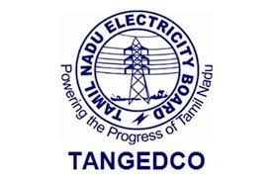
Electricity Bill Payment System Using Core Java
Created by :
1.)ANANDARAJ A
2.)KANNADHASAN
batch code : 10141
Centre name :tambaram ,chennai
Guided by :
Praisy J

Slide 2
Explanation
"Our project, the Electrical Billing System, automates billing processes, minimizes errors, and enhances security using Core Java. It's a modern solution for efficient and accurate electrical billing.“

Slide 3
Hardware and software
Software Used:
PROCESSOR :HP i3 7th gen Laptop.
SYSTEM PROCESSOR SPEED : 1.70GHZ TO 2.40GHZ.
RAM :8gb Ram .
HARDDISK :500 Gigabyte SSD.
JDK
Java runtime environment
Windows 10
Eclipse IDE
Single language
Version :2023-06 (4.28.0)

Slide 4
Modules
Created main class and using Scanner method user provides input (name, EB number, units consumed)
User Input
Billing Calculation
Payment Processing (Credit Card, Net Banking, UPI)
Authentication
1
If &If-else is used to find the consumed units falls in which condition and bill amount is calculated .
2
For Payment we provided three options , which one is comfortable for consumer can avail it . That achieved by using Switch case() .
3
Authentication is Achieved by created authenticate method and get input as username and pass , using the keyword “equals” which return Boolean output to check given input are correct
4

Slide 5
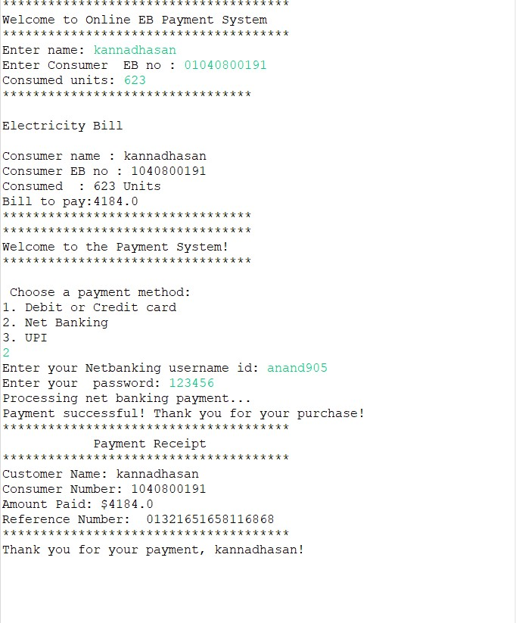
Output
Sample output:

Slide 6
Conclusion
Project Completion: Mention that the project has been successfully completed, and the system is capable of calculating and processing electricity bills.
Achieved Objectives: Summarize the project's main objectives, such as automating the billing process and offering multiple payment options.
User-Friendly: Emphasize that the system is user-friendly, allowing customers to easily input their information and choose their preferred payment method.
Billing Accuracy: Highlight how the system accurately calculates electricity bills based on consumption, ensuring fairness and transparency.
Payment Options: Discuss the different payment options available, including credit/debit cards, net banking, and UPI, providing convenience to customers.
Security: Mention that the system includes security measures, such as authentication for net banking, to protect user data and ensure safe transactions.

Slide 7
the end
THANK YOU

